Slide 1

International Conference on Resource Efficiency in Interorganizational Networks
Göttingen, November 13–14, 2013
organized by the Research Training Group 1703
“Resource Efficiency in Interorganizational Networks
- Planning Methods to Utilize Renewable Resources”

Slide 2
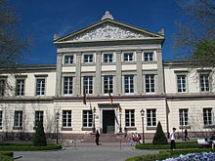
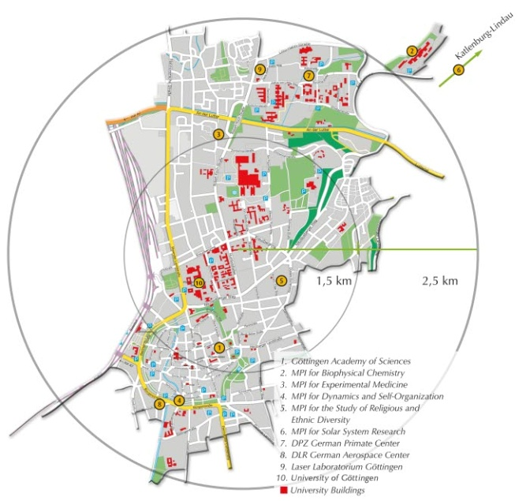
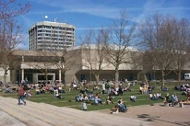

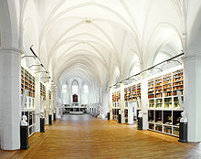
Georg-August-Universität Göttingen
Founded in 1737 by Georg August, King George II of Great Britain,
Elector and Duke of Brunswick-Lüneburg (Hannover)
27 000 students
4 000 Graduates and 750 Doctorates per year
13 Faculties with 450 Professors
15 000 Employees (including Medicine)
Initially, the Pauliner Church was part of a Dominican monastery founded in Göttingen in 1294. In 1812, the newly-created upper storey of the Pauliner Church became part of the University’s library.

Slide 3

Goettingen Research Campus
Georg-August-Universität Göttingen
Faculties of
Agricultural Sciences
Biology and Psychology
Chemistry
Forest Sciences and Forest Ecology
Geoscience and Geography
Mathematics and Computer Science
Physics
Law
Social Sciences
Economic Sciences
Humanities
Theology
Medicine (UMG)
(Involved in RTG 1703)
Göttingen Academy of Sciences
German Primate Center
German Aerospace Center (DLR)
Max Planck Institutes
for Biophysical Chemistry
for Dynamics and Self-Organization
for Experimental Medicine
for Solar System Research
for the Study of Religious and Ethnic Diversity

Slide 4
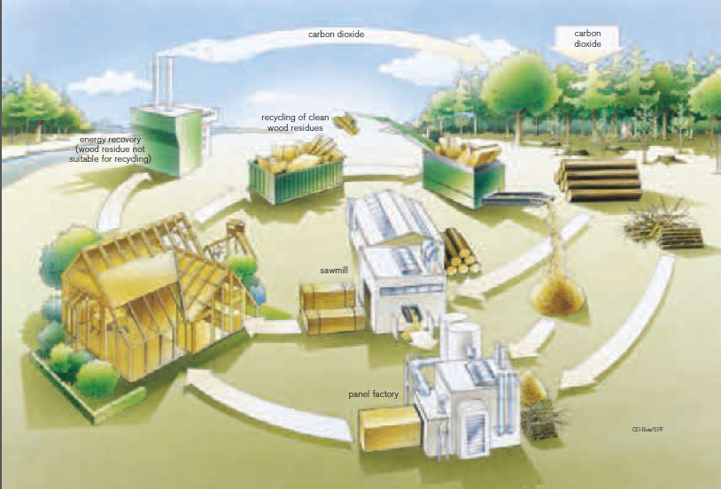
The production of renewable resources has increased significantly in recent years – mainly towards energy crops
Closed Loop Recycling Management and
Cascade Utilization
Wouldn't it be better to strive for an increase
in the cascade utilization of renewable resources?

Slide 5
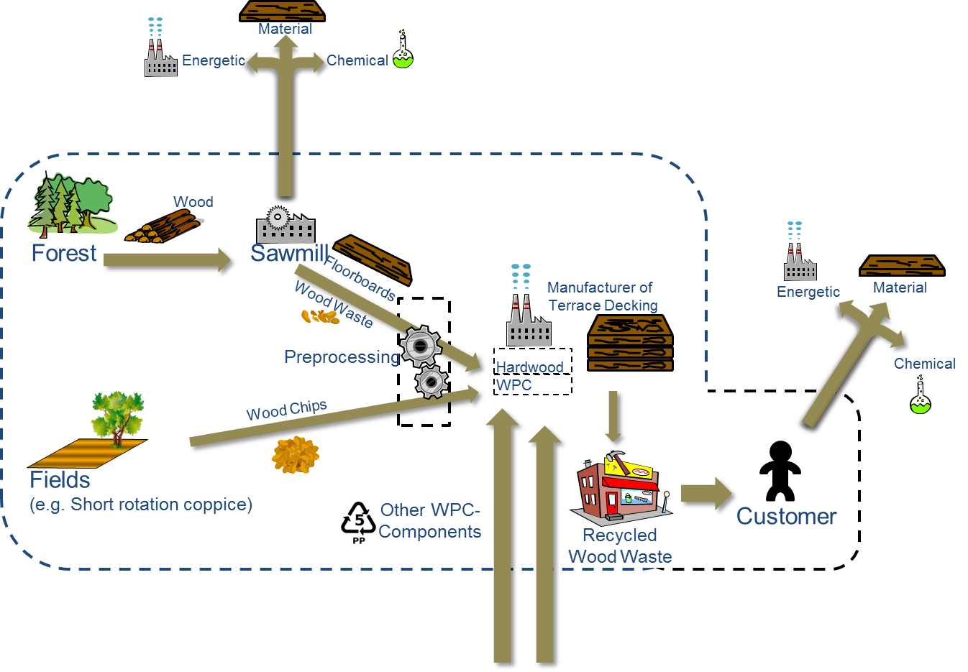
Methods for improving the efficient use of renewable resources and Case studies from the forestry and wood cluster

Slide 6

The interdisciplinary Research Training Group on Resource Efficiency started in 2012, funded by the German Research Foundation
Governance (C)
Information
Systems
Information Management
Organisation Management
Forestry
Processing/
Refinement/
Recycling
Step 1
Processing/
Refinement/
Recycling
Step j
Processing/
Refinement/
Recycling
Step m
Wood Technology
Market
Agri-
culture
Material Sciences (A)
Production & Logistics
Applied
Mathematics
Retailing
Agricultural Engineering
Operative Planning (B)

Slide 7
International Conference on
Resource Efficiency in Interorganizational Networks
Track A:
Materials and Technologies
  Characterization of Fibres and Particles
  Supply Chain of Renewable Resources
  Usage of Cell Wall Components, esp. Hemicelluloses
Keynote:
  Prof. Barry Goodell
  Sustainable Biomaterials, Virgina Polytechnic Inst. and State University
Track B:
Planning of Production and Value-added Networks for Renewable Resources
  IS and IM in Value-Generating Networks for Renewable Resources
  Mathematical Optimization in the Presence of Uncertainties
  Modeling of Production and Logistic Systems
Keynote:
  Prof. Adisa Azapagic
  Sustainable Chemical Engineering, University of Manchester
Track C:
Governance, Coordination and Sale
  Consumer Behavior towards Eco-Friendly Products
  Distribution of Intermediate and End Products from Renewable Resources
Keynote:
  Prof. Daniela Kleinschmit
  Department of Forest Products, Swedish University of Agricultural Sciences, Uppsala
Keynote: Dr.-Ing. Stefan Vodegel / Prof. Martin Faulstich (CUTEC Institute of Environmental Technology): State of the art of German Biomass Power Plants

Slide 8
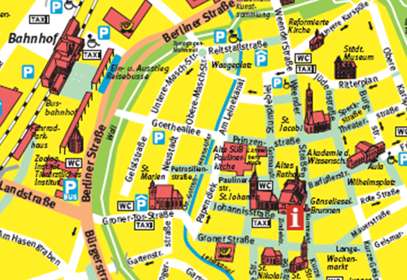
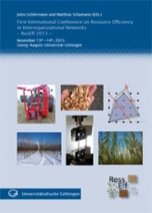

International Conference on
Resource Efficiency in Interorganizational Networks
Statistics:
42 presentations
Participants from 10 countries: Austria, Finland, Great Britain, Italy, New Zealand, Romania, Spain, Sweden, USA, Germany.
Organizational issues:
Lunch is in this building (Paulinerkirche)
included in the conference fee
Dinner on Wednesday evening is
in the Kartoffelhaus (Goetheallee)
Printed proceedings are included in
the conference fee.
Open access:
http://webdoc.sub.gwdg.de/univerlag/2013/ResEff.pdf
Special Volume on „Resource efficiency and cascading
utilization of renewable materials” of the
Journal of Cleaner Production (Call for Papers in Decembre 2013)

Slide 9
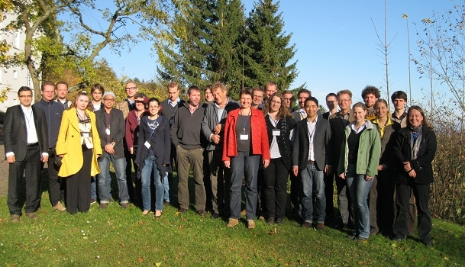
Organizers of the Conference

Slide 10


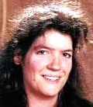

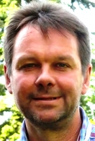


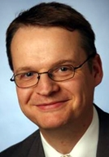
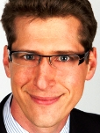
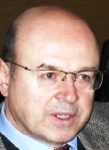

Principal Investigators of the Research Training Group
Prof. Dr. Jutta Geldermann,
Chair of Production and Logistics,
Faculty of Economic Sciences,
University of Göttingen
Prof. Dr. Matthias Schumann,
Chair of Application Systems and E-Business, Faculty of Economic Sciences, University of Göttingen
Prof. Dr. Anita Schöbel,
Research Group Optimization, Institute of Numerical and Applied Mathematics, University of Göttingen
Prof. Dr. Wolfgang Lücke (associated),
President of the University of Osnabrück, University of Osnabrück
Prof. Dr. Holger Militz,
Department of Wood Biology & Wood Products, Faculty of Forest Sciences and Forest Ecology, University of Göttingen
Prof. Dr. Lutz M Kolbe,
Chair of Information Management, Faculty of Economic Sciences, University of Göttingen
Prof. Dr. Waldemar Toporowski,
Chair of Marketing and Retailing, Faculty of Economic Sciences, University of Göttingen
Prof. Dr. Andreas Krause (associated),
Department of Mechanical Wood Technology, University of Hamburg
Dr. Jens-Karl Wegener (associated),
Institute for Application Techniques in Plant Protection, Julius Kühn-Institut, Braunschweig
Prof. Dr. h.c. František Hapla (associated),
Department of Wood Biology & Wood Products, Faculty of Forest Sciences and Forest Ecology, University of Göttingen
Prof. Dr. Stephan Westphal,
Research Group Optimization, Institute of Numerical and Applied Mathematics, University of Göttingen

Slide 11
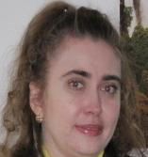
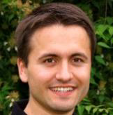
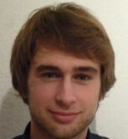
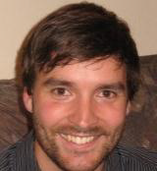
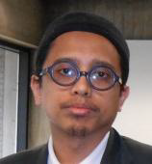
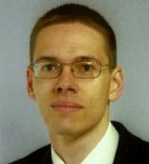
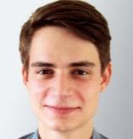
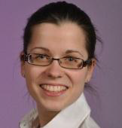

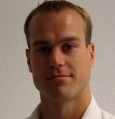
PhD Students
Shanna Appelhanz, M.Sc.
Tracking & tracing systems in value-generating networks for the industrial material utilization of renewable resources
Christoph Kämpfer, M.Sc.
Characterization of the by-products from the agricultural sector concerning their suitability for high quality applications
Dipl.-Math. Marco Bender,
Online algorithms for optimization in the forestry and agricultural sciences
Dipl.-Math. Ingo Karschin,
Modeling of selected logistic networks for renewable resources from by-products and cascade utilization, taking uncertainties and risk management into consideration
Shahril Anuar Bin Bahari, M.Sc. Characterization of the by-products in the lumber industry concerning their suitability for high quality applications of innovative products
Sebastian Ludorf, M.Sc.
Marketing of products made from renewable resources and complementary services in B2B relationships
Dipl.-Holzwirt. Felix Haiduk,
Pre-utilization of wood and other renewable resources through the extraction of chemical raw materials
Victoria-Sophie Osburg, M.Sc.
Consumer acceptance of products from renewable resources and complementary services
Dipl.-Math. Jonas Ide,
Robust multi-criteria optimization
Fabian Renatus, M.Sc.
Multi-objective decision support for hierarchical production planning in recycling cascades

Slide 12
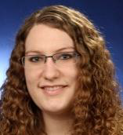
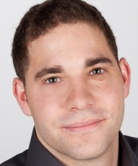
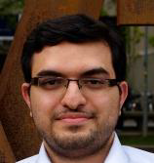
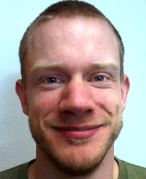
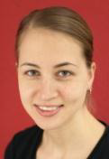
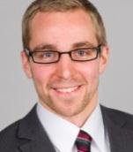
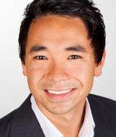
PhD Students
Maren Schlauß, M.Sc.
Characterization of the by-products from the agricultural sector concerning their suitability for high quality applications of modern products
Sebastian Zander, M.Sc.
Efficient structural patterns of inter-organizational corporate networks for renewable resource use
Mohammad Sadegh Taskhiri, M.Sc.
Modeling of selected logistic networks for renewable resources from by-products and cascade utilization, taking uncertainties and risk management into consideration
Matthias Garbs, M.Sc.
Multi-objective decision support for hierarchical production planning in recycling cascades
Laura Teuber, M.Eng.
Characterization of the by-products in the lumber industry concerning their suitability for high quality applications of innovative products
Morten Tiedemann, M.Sc.
Online algorithms for optimization in the forestry and agricultural sciences
Simon Trang, M.Sc.
Management and IT governance in value-generating networks for renewable resources

